Slide 1
Agile development

Slide 2
Benefits of Agile Methodology
Faster, lighter, more engaged mindset.
Customer driven
Much less wasted time spent developing in the wrong direction
Quicker to respond to changes
Faster software development life cycle
Increased customer satisfaction. Customer gets iterations of something very close to what they want, very fast
Values employees. by entrusting agile team with the goal, they are more hands on and sees the obstacle every day. Agile team is in the best position to respond to challenges and meet the goals at hand
Eliminates rework. By involving the customer more, the project remains on-track with customer needs at every step. This means less backtracking and less down time between the work and customer feedback.

Slide 3
When to use Agile development
In rapidly changing business environment (competition)
40% project using traditional SDlC waterfall fail due to mistake made in early phases e.g. Phoenix
Project teams have to work directly with customers to understand the changing goals and provide solutions in a fast incremental way
Look to deploy the first increment in a couple of weeks to refine requirement
Entire software written in months not years
Afford collaboration and communication in daily scrum meeting
Get feedback early and velocity is measured in each increment
Self organizing team: goal oriented and management rules

Slide 4
Scrum
Product owner draft a prioritized wish list called Backlog
The scrum team takes one small piece of the top of the wish list called a sprint backlog and plans to implement it.
The team completes their sprint backlog task in a sprint (a 2-4 week period). They assess progress in a meeting called a daily scrum.
The ScrumMaster keeps the team focused on the goal.
At the sprint’s end, the work is ready to ship or show. The team closes the sprint with a review, then starts a new sprint.

Slide 5
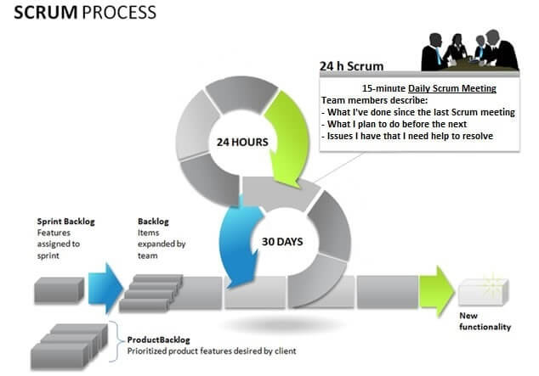
Agile process

Slide 6
Best Practices in Agile Development
Set priorities. A product backlog is a list of prioritized tasks maintained by a product owner
Maintain small release cycles. The product should be released in increments every 2-4 weeks, with stakeholders giving feedback before proceeding
Use pair programming. Two programmers work side-by-side at a single computer. Identical degree of productivity to separate programming but delivers higher quality.
Refactor. Rework code regularly to achieve the same result with greater efficiency and clarity.
Use test-driven development. Code the unit test first. Test-driven development produces greater employee engagement in coding challenge.

Slide 7
Question to Ford
What is reason behind choosing Agile development process?
What practices of Agile will the team be using?
Will there be a daily scrum meeting?
Do the stakeholders show up in the sprint review meeting every two weeks?
Who are the stakeholders? Platform and feature code owners?
If the stakeholders are just the features code owners? Who decides on conflicting priorities? The platform owner?
Will the scrum master and product owner be the same person in this 4 month project?
Is this a test driven environment where you can start writing test code right from the start?
Will there be pair programming?

